Slide 1
Getting Started With

Slide 2
Our Team
Angelica Cionci Amy Safirstein Undergraduate Programs Graduate Programs Instructional Technologist Instructional Technologist angelica.cionci@temple.edu amy.safirstein@temple.edu 215-204-6349 215-204-7051
Email us at: foxzoom@temple.edu

Slide 3
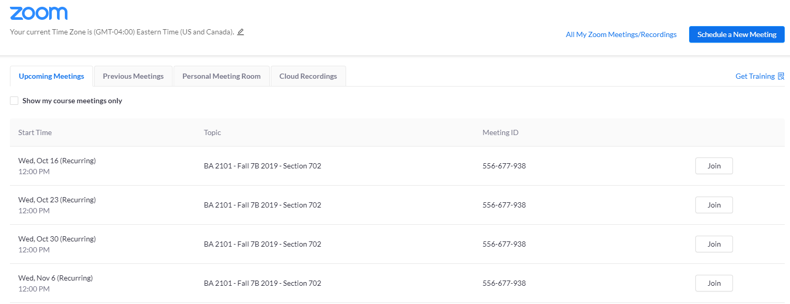
Zoom LTI in Canvas
Enable LTI in Canvas course (if not already, we can help with this)
Click “Zoom” on navigation bar (to the left)
The main “upcoming meetings” tab will show any meetings you have scheduled for your course
Students can see all upcoming classes and start their meeting directly from this screen by selecting the “Join” button for each class meeting.
*Select the “Schedule a New Meeting” button to create your class sessions
Notes:
Share desktop and walk through this setup on Canvas

Slide 4
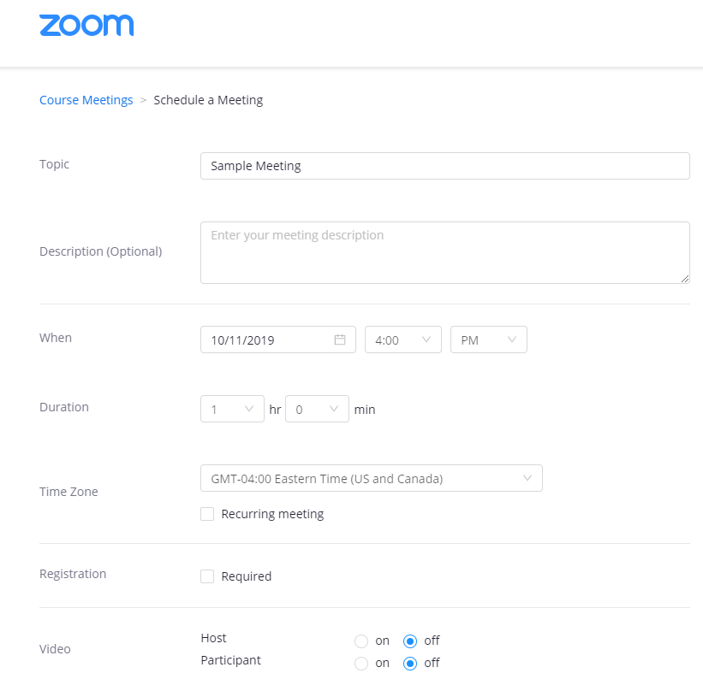
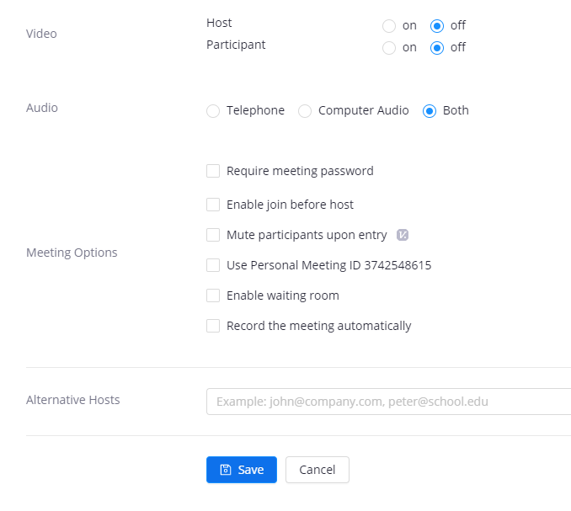
Scheduling A Meeting
“Schedule a New Meeting”
Enter a topic
When (Date & Time)
Duration (optional)
Select “Recurring Meeting” to schedule a series of class meetings
Select the settings you wish
“Save”
Notes:
Share desktop and walk through this setup on Canvas

Slide 5
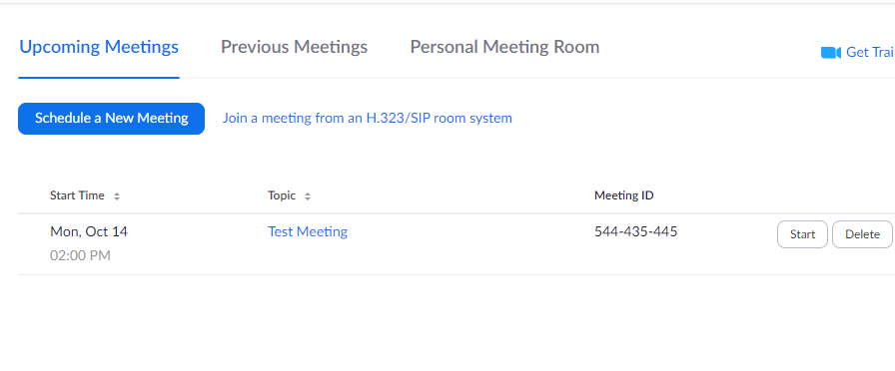
Starting A Class Meeting
Login to Canvas
Go to your Canvas course
Click “Zoom” (on the left navigation)
Click “Start” for your upcoming meeting from the home screen (Upcoming Meetings Tab)
Notes:
Share desktop and walk through this setup on Canvas - Use ODL Canvas course

Slide 6
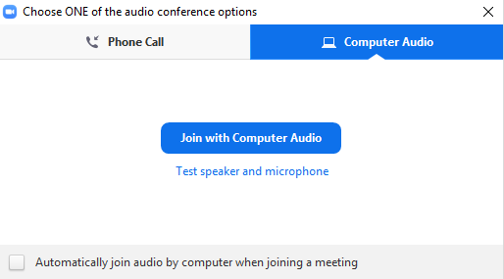
Connecting Audio/Video
Chose “Computer Audio” “Join with Computer Audio”
“Test Speaker and Microphone”
You can turn your mic and video on and off using the icons on the control bar once in your session. Audio and video settings can be found by selecting the chevrons next to the audio and video icons

Slide 7
Meeting Controls / Navigation
Join Audio
Start Video
Invite
Manage Participants
Polls
Share
Chat
Record
Closed Caption
Breakout Rooms
*Zoom.temple.edu to change meeting settings*

Slide 8
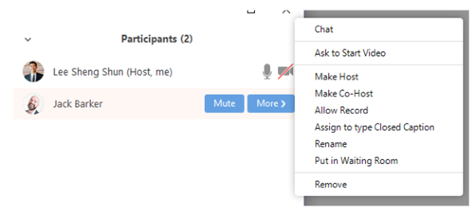
Participant Controls
Hovering over a name will allow you to control certain aspects of their participation or open a direct chat with that participant.

Slide 9
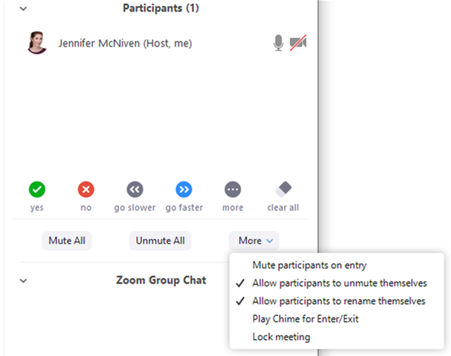
Participant Controls
On the bottom of your participant panel you will see options to Mute All, Unmute All, and select from More options.
These options include muting attendees on entry, allowing participants to unmute and rename themselves, playing a chime when someone enters or exits, and locking the meeting (which prevents anyone else from entering it).

Slide 10
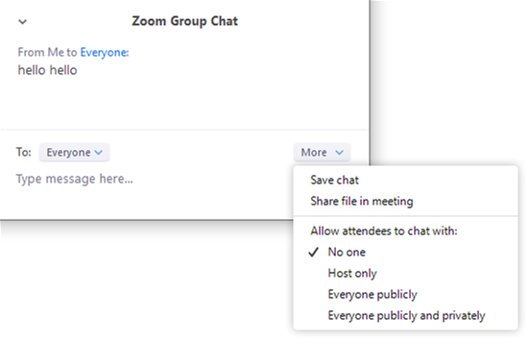
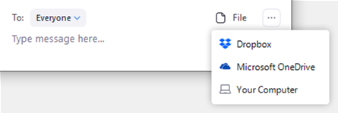
Chat Box
Hosts can delineate who attendees can chat with
Files can be uploaded and shared with the meeting by selecting the File icon in the chat box. Attendees can view and download files shared with them in the chat.

Slide 11
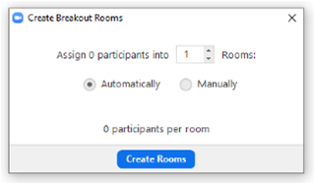
Breakout Rooms
Breakout rooms should be enabled automatically for your Zoom sessions. If you do not see the Breakout Rooms icon on your meeting control bar, check your Zoom settings to ensure that the Breakout Room function has been toggled on.
Once your Zoom session has started, select the Breakout Rooms icon to set up and launch your Breakouts. The breakout groups that you create will be available to re-open through the rest of the session, if you wish. You can also choose to create new groups at any time.

Slide 12
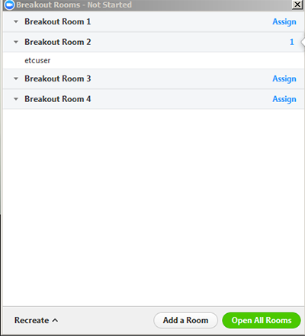
Breakout Rooms Important Features
Automatic vs. Manual Room set up

Slide 13
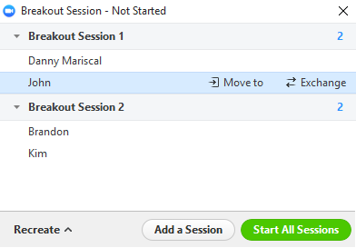
Breakout Rooms Important Features
Move Participants Between Rooms

Slide 14
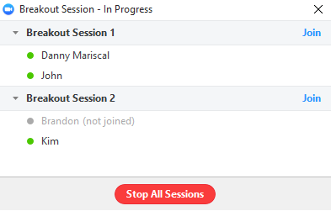
Breakout Rooms Important Features
Easily Join a Room

Slide 15
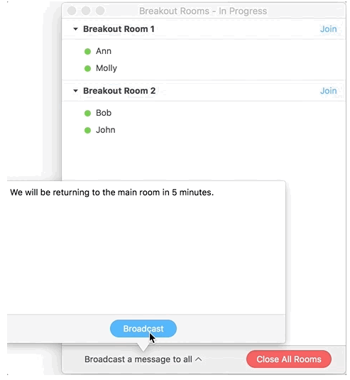
Breakout Rooms Important Features
Broadcast a Message

Slide 16
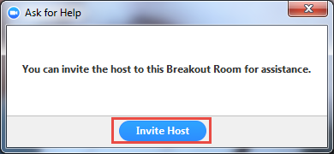
Breakout Rooms Important Features
Ask for Help

Slide 17
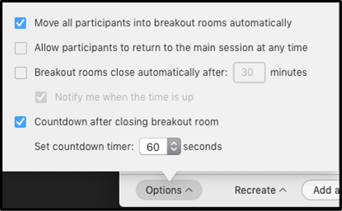
Breakout Rooms Important Features
Other Options

Slide 18
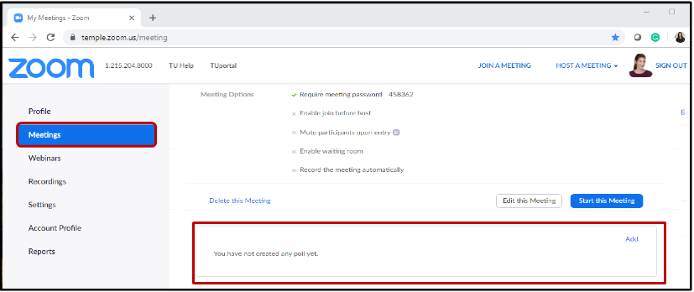
Polls Creating and Sharing
To create polls ahead of time for your class, select the meeting session from your Upcoming Meetings list in the Zoom Meetings tab
> Select the meeting
> Scroll down the page
> Select Add in the Polling box at the bottom of the page

Slide 19
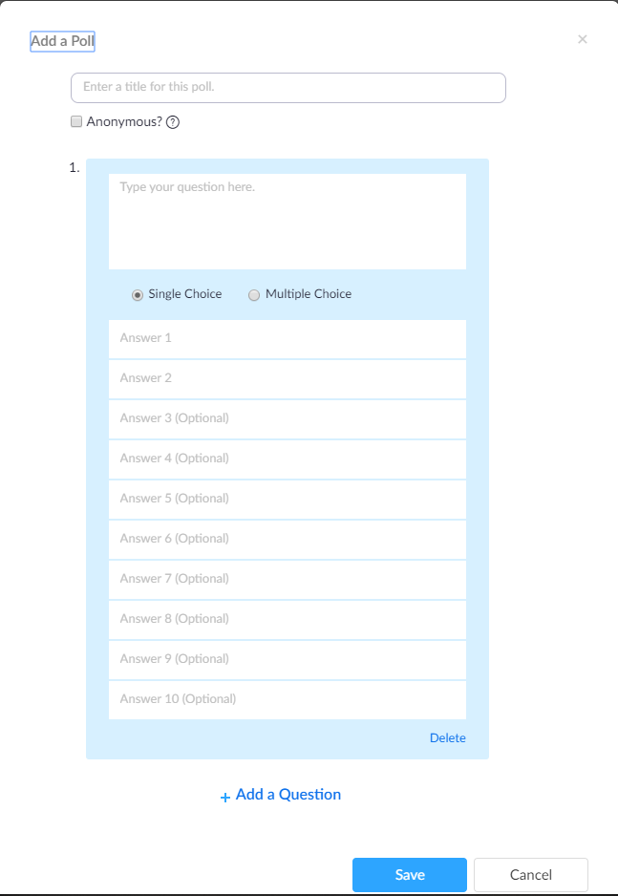
Polls Creating
Selecting Add poll will open the poll building tool. You can specify whether the poll is anonymous or not.
> Name the poll
> Type your poll question and designate whether it’s a single or multiple-choice question
> Add all possible answers and save. This will make sure the poll is waiting for you once the Zoom session has started.

Slide 20
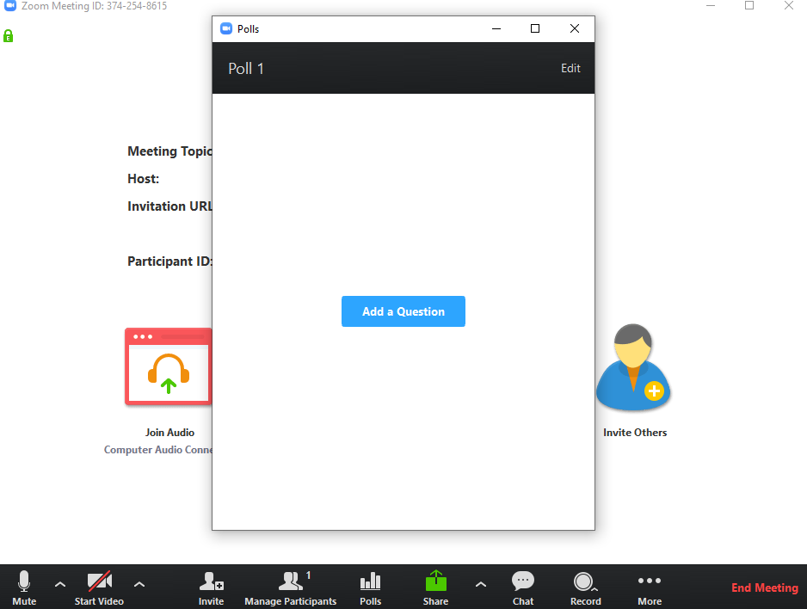
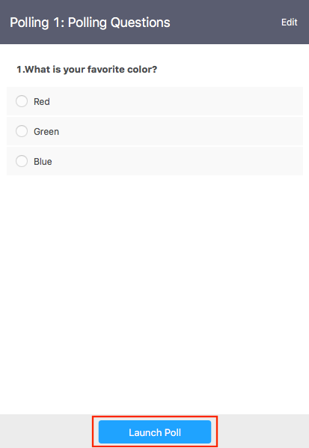
Polls Creating
Once your Zoom session is running, you can easily launch your polls at any time.
> Select Polls from the control bar
> The pop-up will either ask you to add a poll question or select from existing poll questions
> Once selected or built, you will see your question in the pop-up. Select Launch Poll to share it with attendees

Slide 21
Polls Creating
Once your poll is running, you will see results coming in live.
> Select End Polling when you are ready to close the poll
> You will be able to review poll results, then Share Results with the session.
> To retrieve a report of your poll results for a session, go to the Reports tab of your Zoom account and locate the session under Meetings

Slide 22
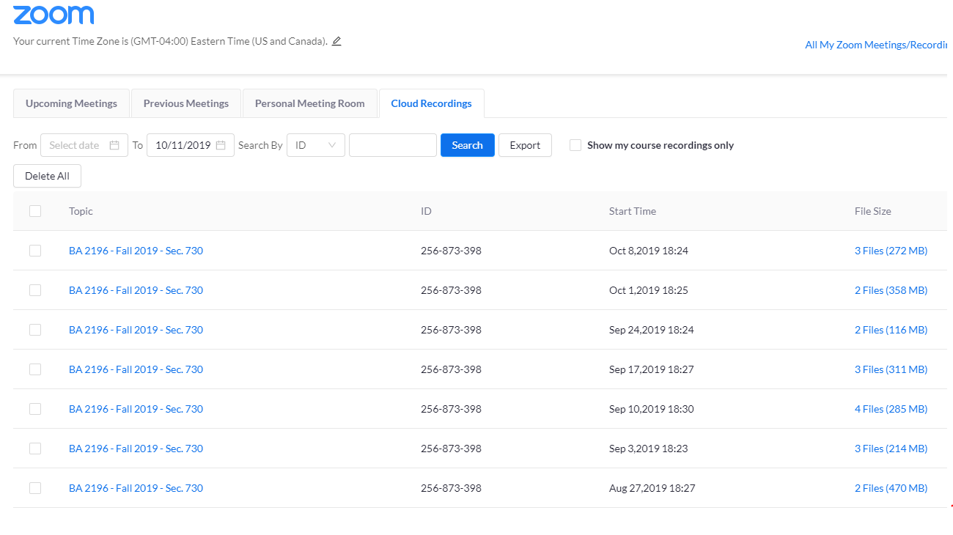
Class Recordings
When you record to the cloud during your class sessions, you and your students can find your class recordings from the Zoom tab in your Canvas course
Select the “Cloud Recordings” tab to access all of your recordings
You can choose to stream the video, download the mp4, or share the video
Your recording transcript will be played alongside the video and can be downloaded separately
Notes:
Share desktop and walk through this setup on Canvas - Use ODL Canvas course

Slide 23
Questions?

